Slide 1

Apple Vision Pro Tweets
DIVYA SHARMA (DS655)

Slide 2
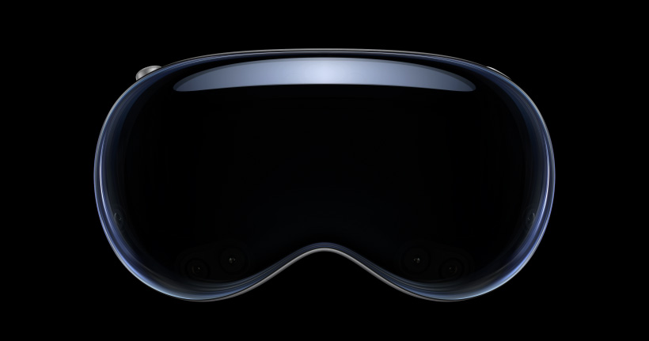
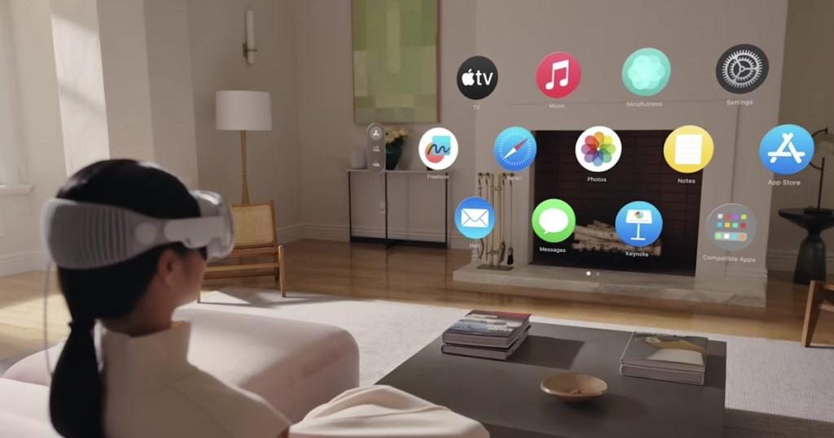
Introduction
Apple Vision Pro was launched on Feb 02, 2024, and it revolutionized AR experiences with its advanced capabilities
Praised for its seamless integration of virtual elements into the real world, it's hailed as a game-changer in various industries, from design to gaming, garnering widespread acclaim for its innovation and potential

Slide 3
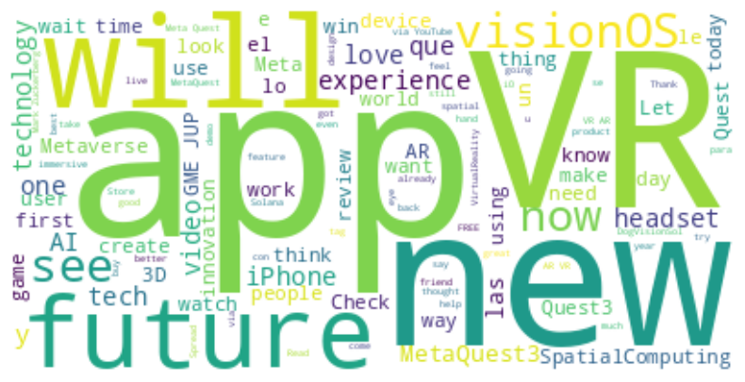
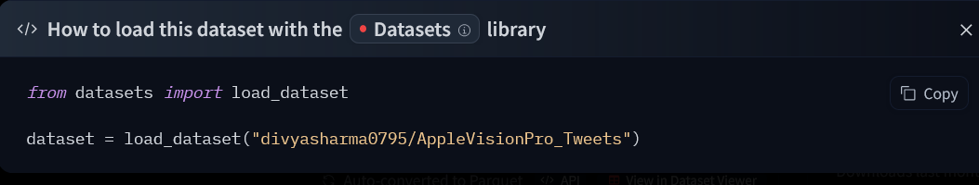
Dataset
The dataset comprises 26,704 tweets collected over Jan 2024 and March 2024
The data was scraped using Twitter’s API using Auth v2.0
The search terms used were the hashtag “#AppleVisionPro” and “Apple Vision Pro”
The data was loaded onto HuggingFace, and can be accessed publicly for analysis

Slide 4
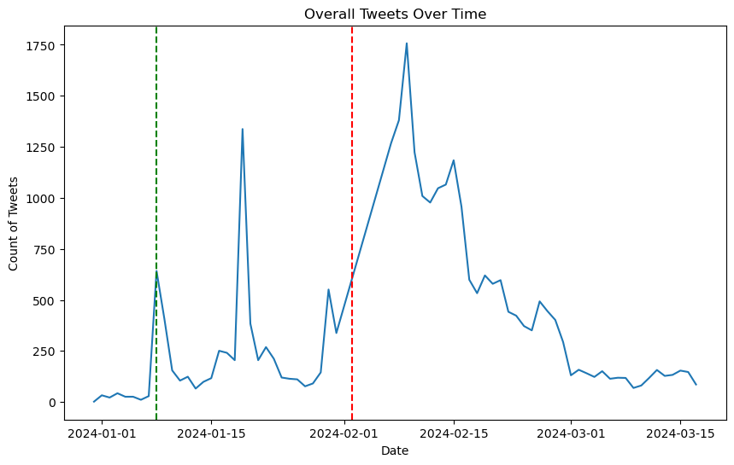
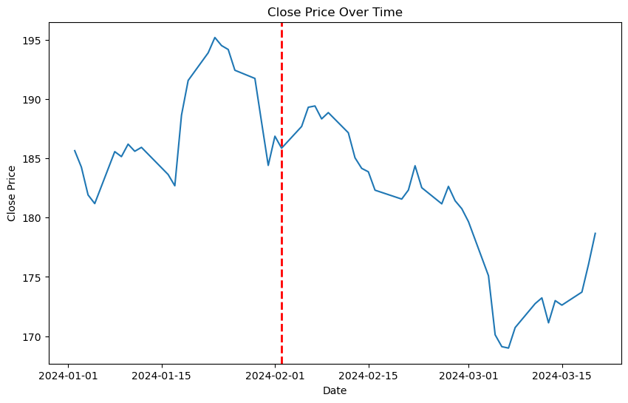
Tweet Volumes by day
The Apple Vision Pro US availability press release was on Jan 08, 2024 (green line) – this led to an increase in the number of tweets as well as stock prices for apple
The product was available from Feb 02, 2024 (red line) – this led to an increase in the number of tweets as well as a short increase in the stock price

Slide 5
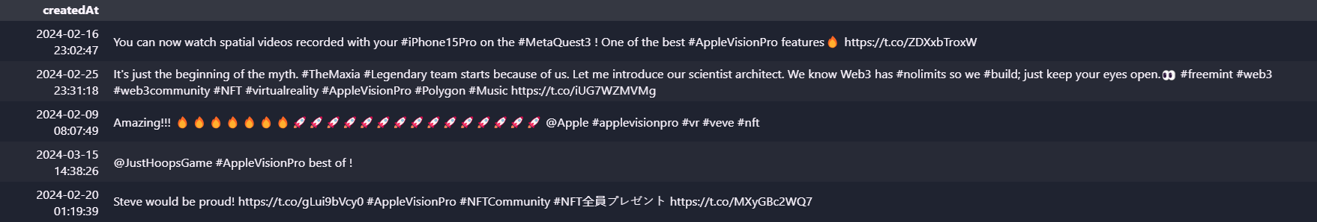
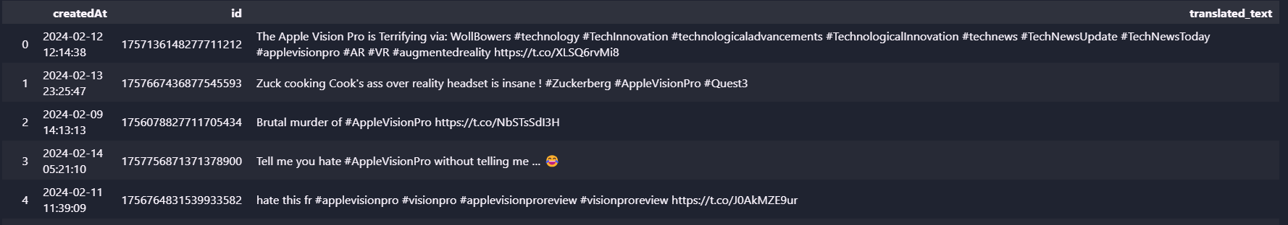
Sentiment Analysis
Since the tweets were unlabelled, sentiment analysis needed to be performed to gather conclusions based on the data
Positive Tweets Examples
Negative Tweets Examples

Slide 6
Data Preprocessing for sentiment analysis
Original Tweet
Remove #Hashtags
Remove @mentions
Remove URLs
Remove Special Characters
Removing Stop words
Lowercase conversion
Text Translation to English
Stemming and Lemmatization
Data for Model

Slide 7
Sentiment Analysis
Positive
Original Tweet
Model
Neutral
Negative

Slide 8
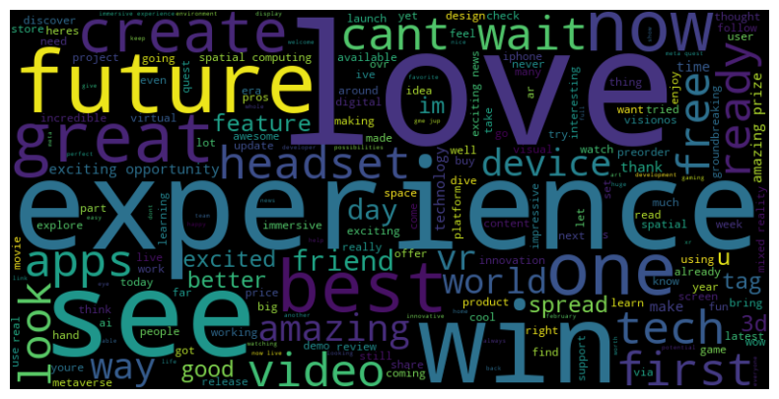
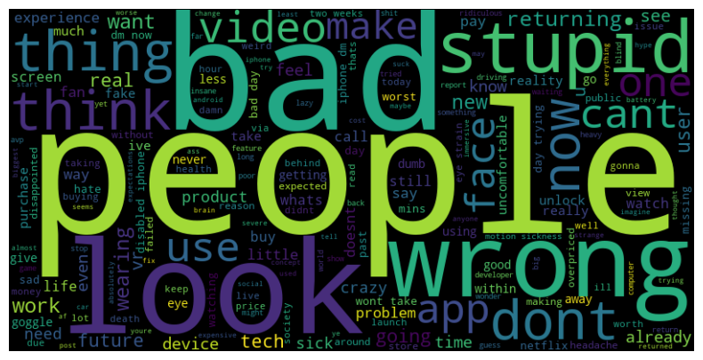
Positive and Negative Tweets
To generate these word clouds, the neutral tweets were excluded
Positive tweets often include words like "love“, "future“, and "experience" reflecting enthusiasm for its innovative features and potential for the future
Negative sentiment tends to be associated with words such as "people“, "wrong“, and "returning" indicating concerns or dissatisfaction related to specific aspects like compatibility or functionality

Slide 9
Sentiment Analysis
4 different models of varying complexities were considered for sentiment analysis
TextBlob Model
VADER Model
DistilBERT Model
RoBERTa Model
Based on pre-defined patterns and word lists, provides simple polarity scores for text sentiment
(Valence Aware Dictionary and sEntiment Reasoner) – rule-based sentiment analysis tool
Distilled BERT model - compact version of BERT, optimized for efficient inference
Transformer based pre-trained model capable of understanding context and nuances

Slide 10
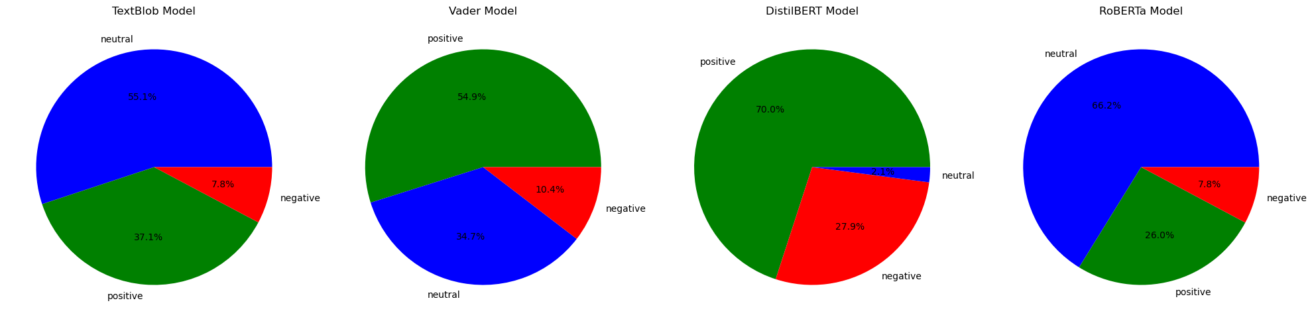
Distribution of tweets based on Polarity

Slide 11
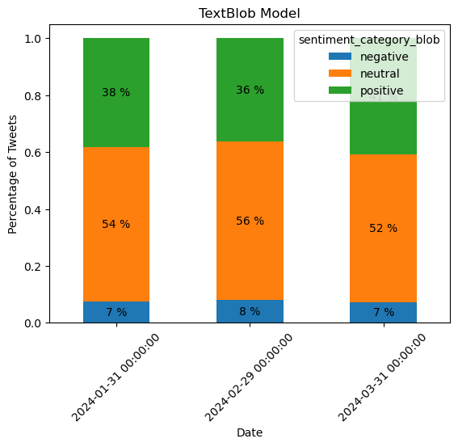
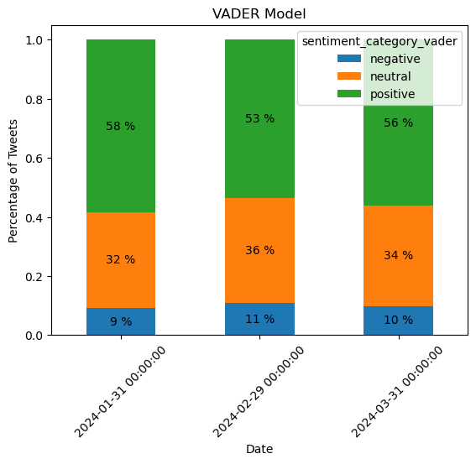
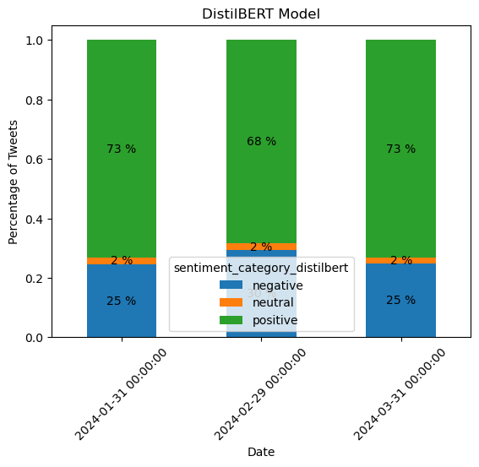
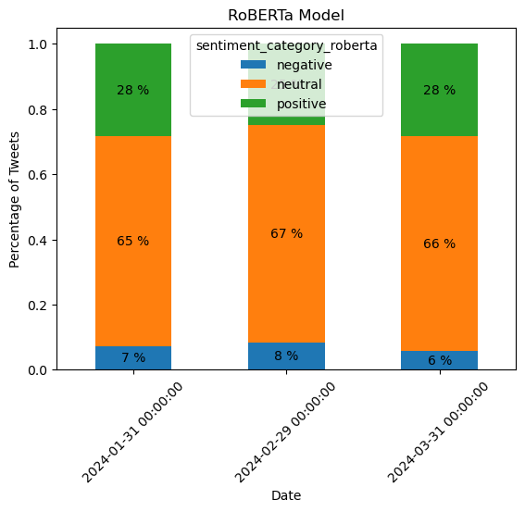
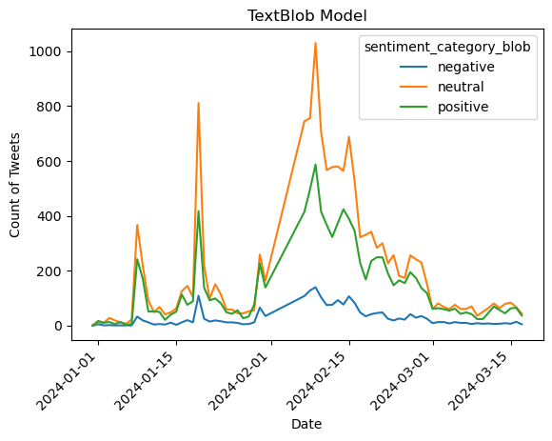
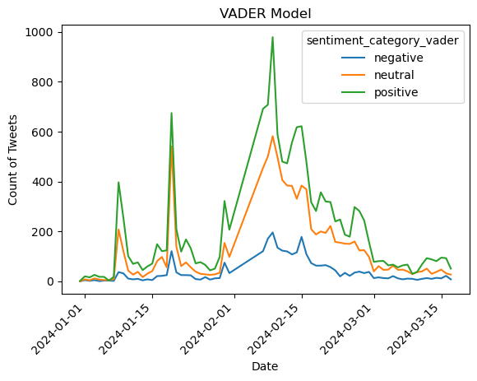
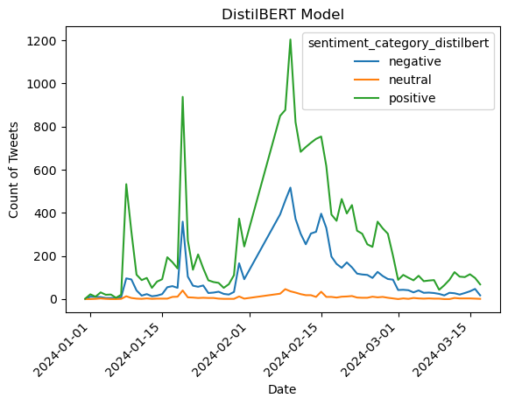
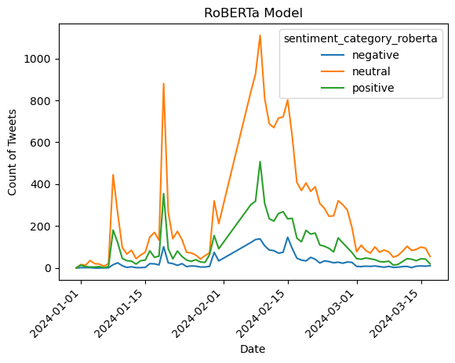
Distribution of tweets based on Polarity over time

Slide 12
Model Differences
Tweet: "AppleVisionPro looks amazing, but the price tag is giving me heart palpitations. #worthit?“
TextBlob Model:
Positive
VADER Model:
Positive
DistilBERT Model
Neutral
RoBERTa Model:
Neutral
Likely because of the “amazing” and the “worth it”
They can capture the sentiment behind the “but” and “heart palpitations”

Slide 13
Model Differences
Tweet: "Finally got my AppleVisionPro! The graphics are unreal, but the FOV feels a little limited. Still cool though!“
TextBlob Model:
Positive
VADER Model:
Positive
DistilBERT Model
Negative
RoBERTa Model:
Neutral
Likely because of the “cool” and “unreal” and “!”
Captures the sentiment but classifies it as overall negative
Captures the sentiment but classifies it as neutral because of the mixed signals

Slide 14
Model Differences
Tweet: “I don’t really get the hype about AppleVisionPro, it seems ok I guess.“
TextBlob Model:
Neutral
VADER Model:
Neutral
DistilBERT Model
Negative
RoBERTa Model:
Neutral
Not enough context to classify as positive or negative
Captures the sentiment but classifies it as overall negative
Captures the sentiment but classifies it as neutral

Slide 15
Model Differences
Tweet: “Wow, the lines for the AppleVisionPro are incredible. I love waiting in crowds for hours.“
TextBlob Model:
Positive
VADER Model:
Neutral
DistilBERT Model
Negative
RoBERTa Model:
Neutral
Does not understand sarcasm, classifies it as a positive tweet
Close to positive (0.05), but weighs “crowds for hours” vs “wow” and “incredible”
Captures sarcasm better than the other models

Slide 16
Model Differences
Tweet: "Just got my Apple Vision Pro and I'm impressed! The learning curve is a bit steep, but the potential is unreal. #WorthTheWait"
TextBlob Model:
Positive
VADER Model:
Positive
DistilBERT Model
Negative
RoBERTa Model:
Neutral
Focuses on the positive terms (impressed, potential, unreal)
Possibly because of “learning curve” and “steep” and “unreal”

Slide 17
Model Summaries
TextBlob Model:
Available with python’s textblob library
Super fast
~3 seconds for 26,705 rows
Useful for basic non-context based classification
Interpretable (training dataset available)
VADER Model:
Available on NLTK (“vader_lexicon”)
Fast
~30 seconds for 26,705 rows
Useful for basic non-context based classification
Interpretable (rule based)
DistilBERT Model
Available on HuggingFace (lxyuan/distilbert-base-multilingual-cased-sentiments-student)
Slower
~25 minutes for 26,705 rows
Useful for context based classification
Non interpretable (complex)
RoBERTa Model:
Available on HuggingFace (cardiffnlp/twitter-roberta-base-sentiment-latest)
Slowest
~40 minutes for 26,705 rows
Useful for context based classification
Non interpretable (complex)

Slide 18
Sentiment Analysis Model Capabilities
TextBlob and VADER:
Provides basic, non-context-based sentiment classification
Answers questions like: "Is this tweet generally positive or negative?"
DistilBERT:
Provides more nuanced, context-aware sentiment analysis
Answers questions like: "How positive or negative is the sentiment expressed in this tweet, and what are the underlying reasons?"
RoBERTa:
Provides the most accurate and contextual sentiment analysis
However, its slower processing time makes it less suitable for this specific use case

Slide 19
Actionable Insights for Apple's Marketing Team
Timing of Announcements
The data shows that the initial press release and product availability dates led to increased tweet volume and stock price fluctuations
Suggests that Apple's marketing and communications strategy around major product announcements is effective in generating buzz and interest
Sentiment Trends
Sentiment analysis can provide insights into how the public perception of the Apple Vision Pro evolved over time
This could inform future product launches and marketing campaigns, helping Apple better understand and respond to customer sentiment
Identifying Influential Tweets
Sentiment analysis could be used to identify the most influential tweets (e.g., those with the strongest positive or negative sentiment)
This could help Apple's marketing team understand the key drivers of public opinion and tailor their messaging accordingly
Competitive Intelligence
Comparing the sentiment analysis of Apple Vision Pro tweets to those of competing products could provide valuable insights
This could help understand how the Apple product is perceived relative to the competition

Slide 20
Evaluating Sentiment Analysis Model Performance
Evaluation on new data
Generate dummy tweets using large language models like ChatGPT with positive, negative, or neutral tags
Assess the model's performance on this new, controlled dataset
Interpretability
Assess how well the model's outputs can be understood and acted upon by the marketing team
Consider the transparency and explainability of the model's decision-making process
Efficiency
Consider the processing time and computational resources required by each model
Evaluate the practicality of deploying each model in terms of scalability and real-time performance

Slide 21
Conclusions
The DistilBERT model stands out as the best choice:
Classifies more tweets as positive or negative, instead of labeling them as neutral
Provides more meaningful and actionable insights compared to simpler models
Relatively fast, taking around 25 minutes to analyze 26,705 tweets
More context-aware and accurate sentiment analysis than simpler models, despite being less interpretable than rule-based approaches
The RoBERTa model is also a strong contender, but the significantly longer processing time of 40 minutes makes it less practical for this use case.
DistilBERT
1
RoBERTa
TextBlob and Vader
2
3

Slide 22
Codes
Dataset: https://huggingface.co/datasets/divyasharma0795/AppleVisionPro_Tweets
Github Repository: https://github.com/DivyaSharma0795/AppleVisionPro_Dataset
Scraping: https://github.com/DivyaSharma0795/AppleVisionPro_Dataset/blob/main/01 Codes/01_API_Data.ipynb
Sentiment Analysis: https://github.com/DivyaSharma0795/AppleVisionPro_Dataset/blob/main/01%20Codes/02_Sentiment_Analysis.ipynb

